Slide 1
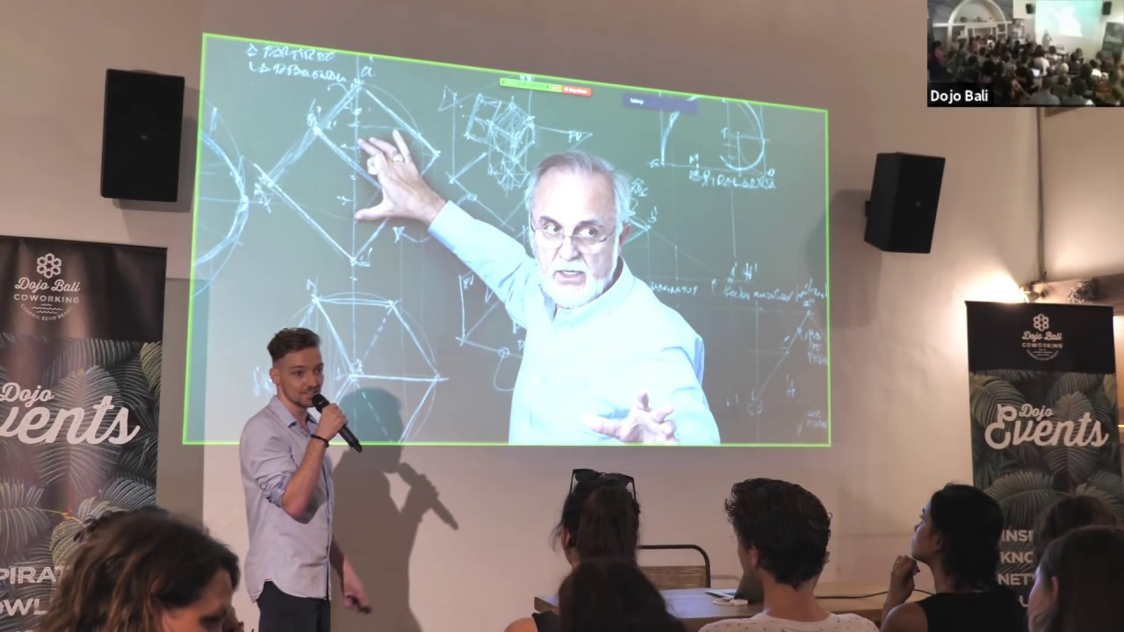
Pieter Levels
The story of a bootstraper entrepeneur

Slide 2

Pieter Levels levels.io

Slide 3
12 Startups in 12 months
From Netherlands to the world
33 years old
He is a Bootstraper Entrepeneur
He studies MBA

Slide 4
His studies
1 year of International Business Administration at Hogeschool Utrecht in 2007.
3 years of International Business Administration at Vrije Universiteit Amsterdam in 2010.
3 months of studying abroad at Korea University Business School in 2009
1 year of Business Administration at Rotterdam School of Management where he graduated in 2012.

Slide 5
HOW HE STARTED
Panda Drum & Bass Mix Show – 2012 – Youtube
He was in Netherland and he traveled to Thailand to become a digital nomad.

Slide 6
12 Startups in 12 months
Play My Inbox
Go F***ing Do It
GifBook
Remote OK
Nomad List
Hood Maps
Make Book

Slide 7

Play my Inbox

Slide 8

GO F***ING DO IT

Slide 9

GIFBOOK

Slide 10
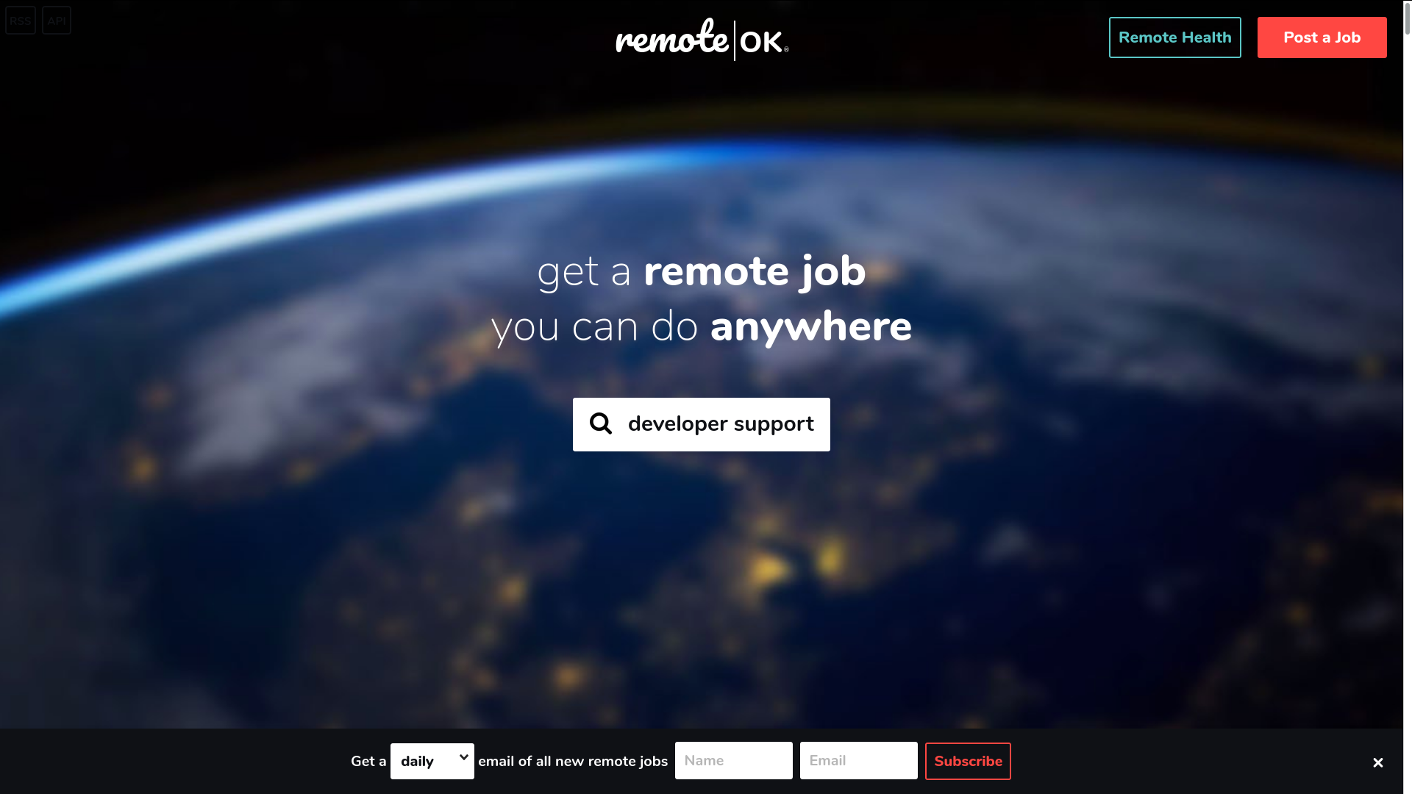
REMOTE OK

Slide 11
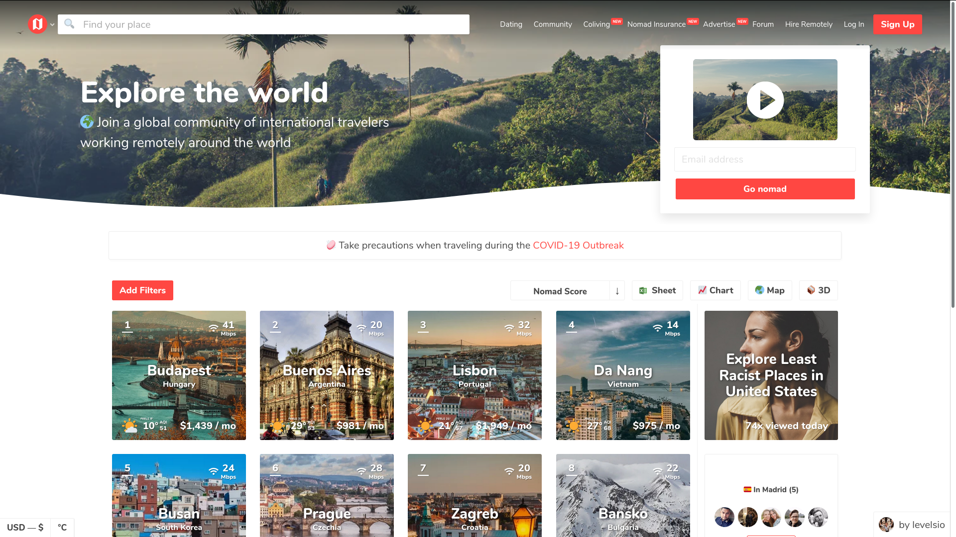
NOMAD LIST

Slide 12
NOMAD LIST

Slide 13
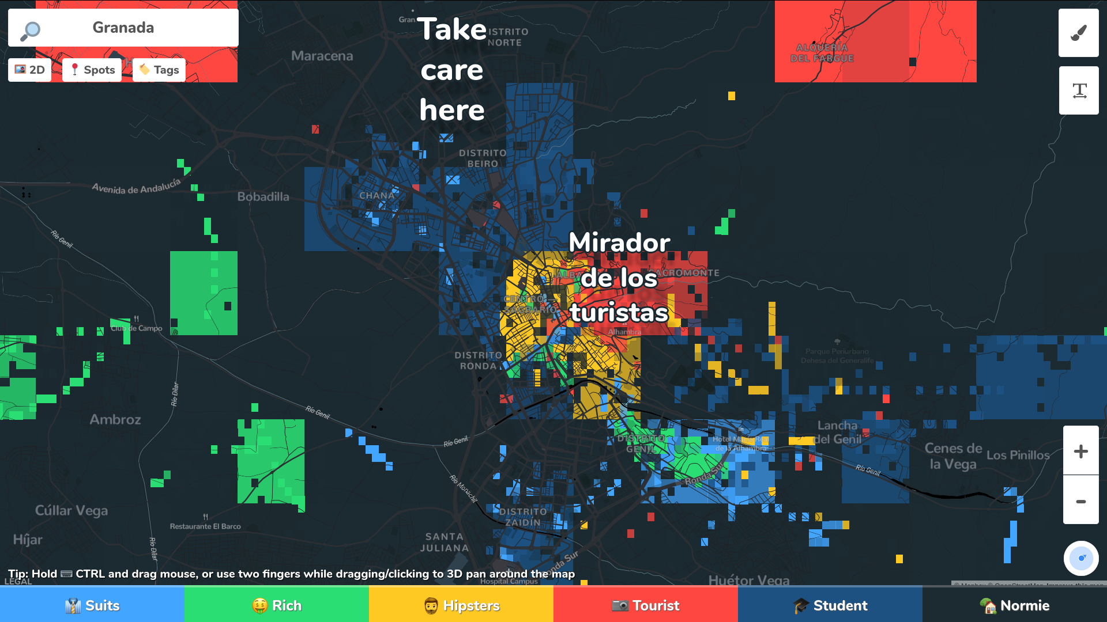
HOOD MAPS

Slide 14
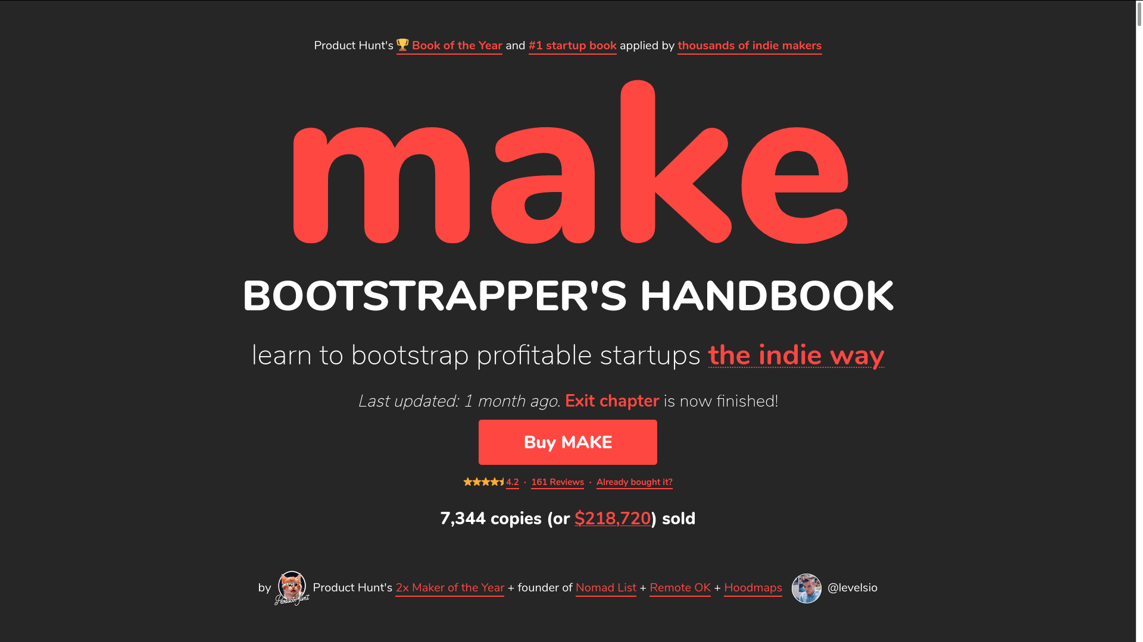
MAKEBOOK

Slide 15
MAKEBOOK
Idea
Build
Launch
Grow
Monetize
Automate
Exit
Ethics

Slide 16
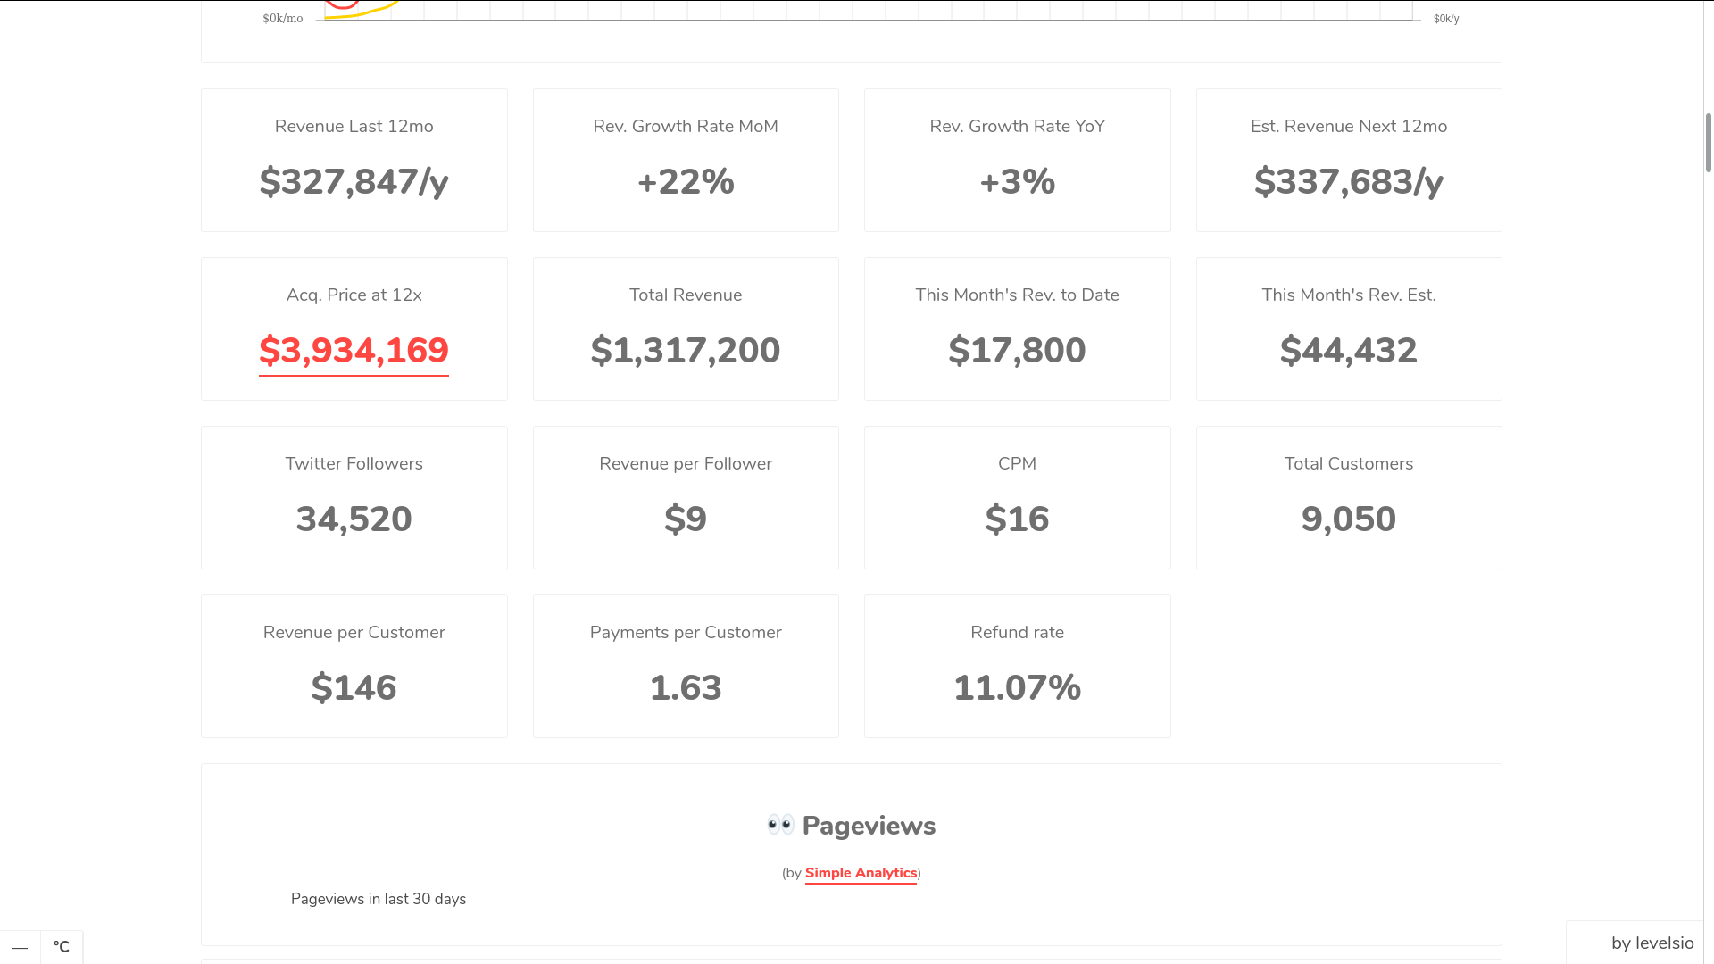
How rich is he?

Slide 17
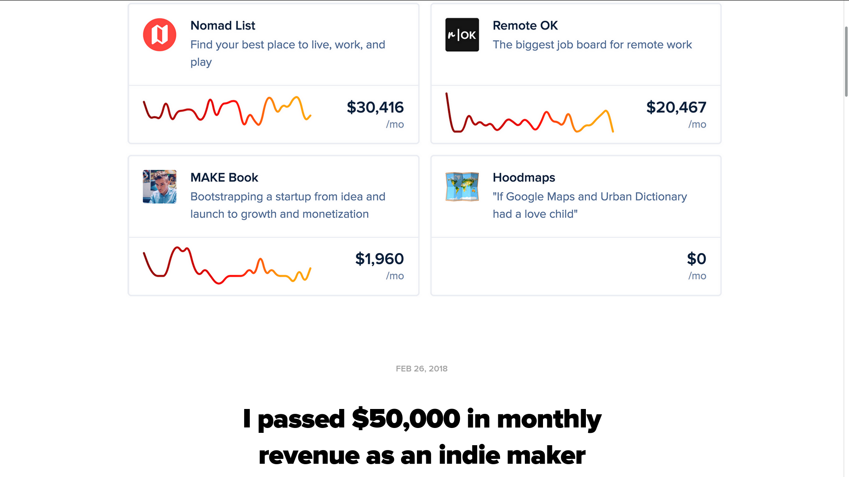

Slide 18
The key for be a bootstarper
Stay focused
Learn by your own
Ask
Be social
Be interactive

Slide 19

Websites

